Slide 1


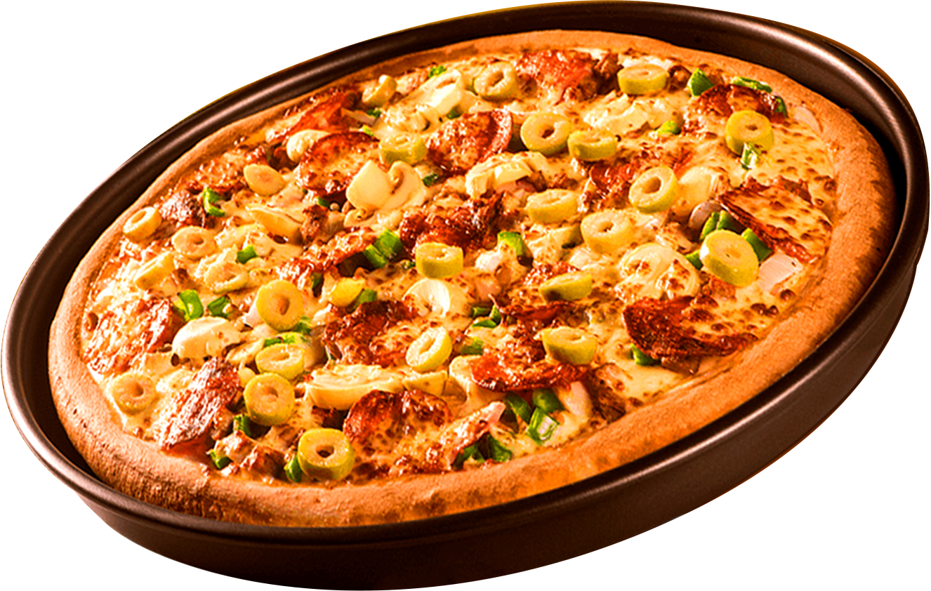
Where Every Slice is a Taste of Perfection
SQL PROJECT ON PIZZA SALES
ORDER
NOW
By: Harveen Kaur

Slide 2
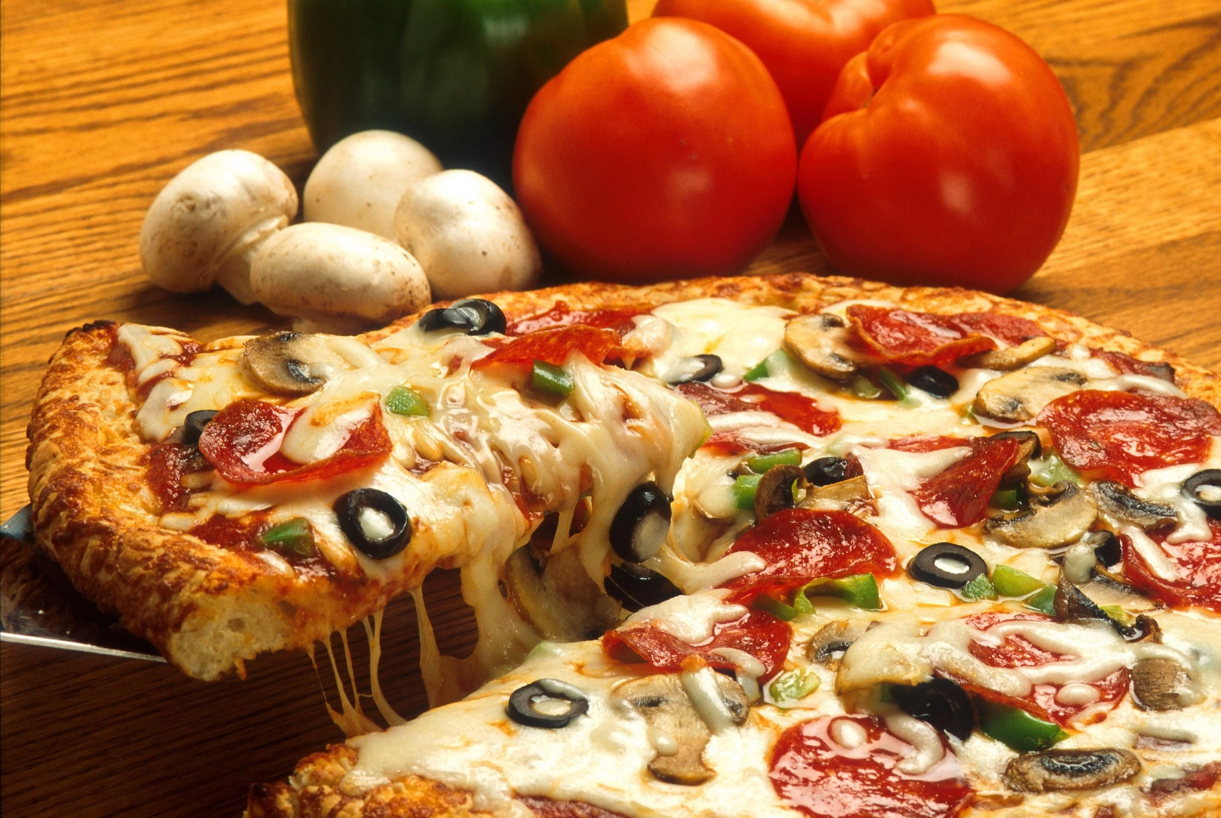
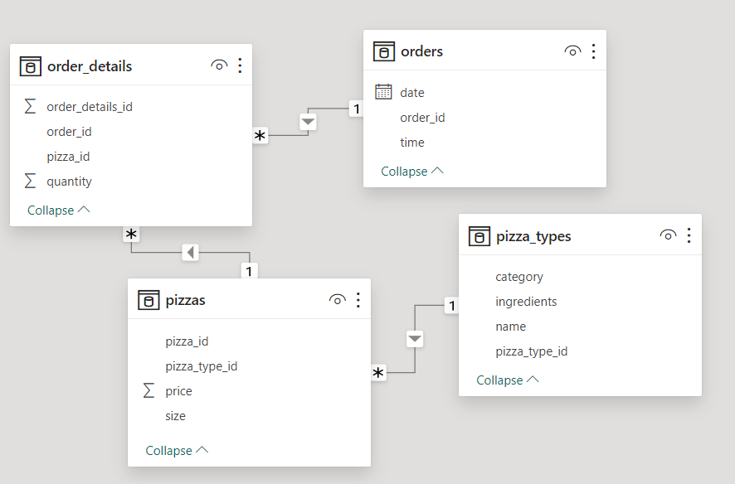
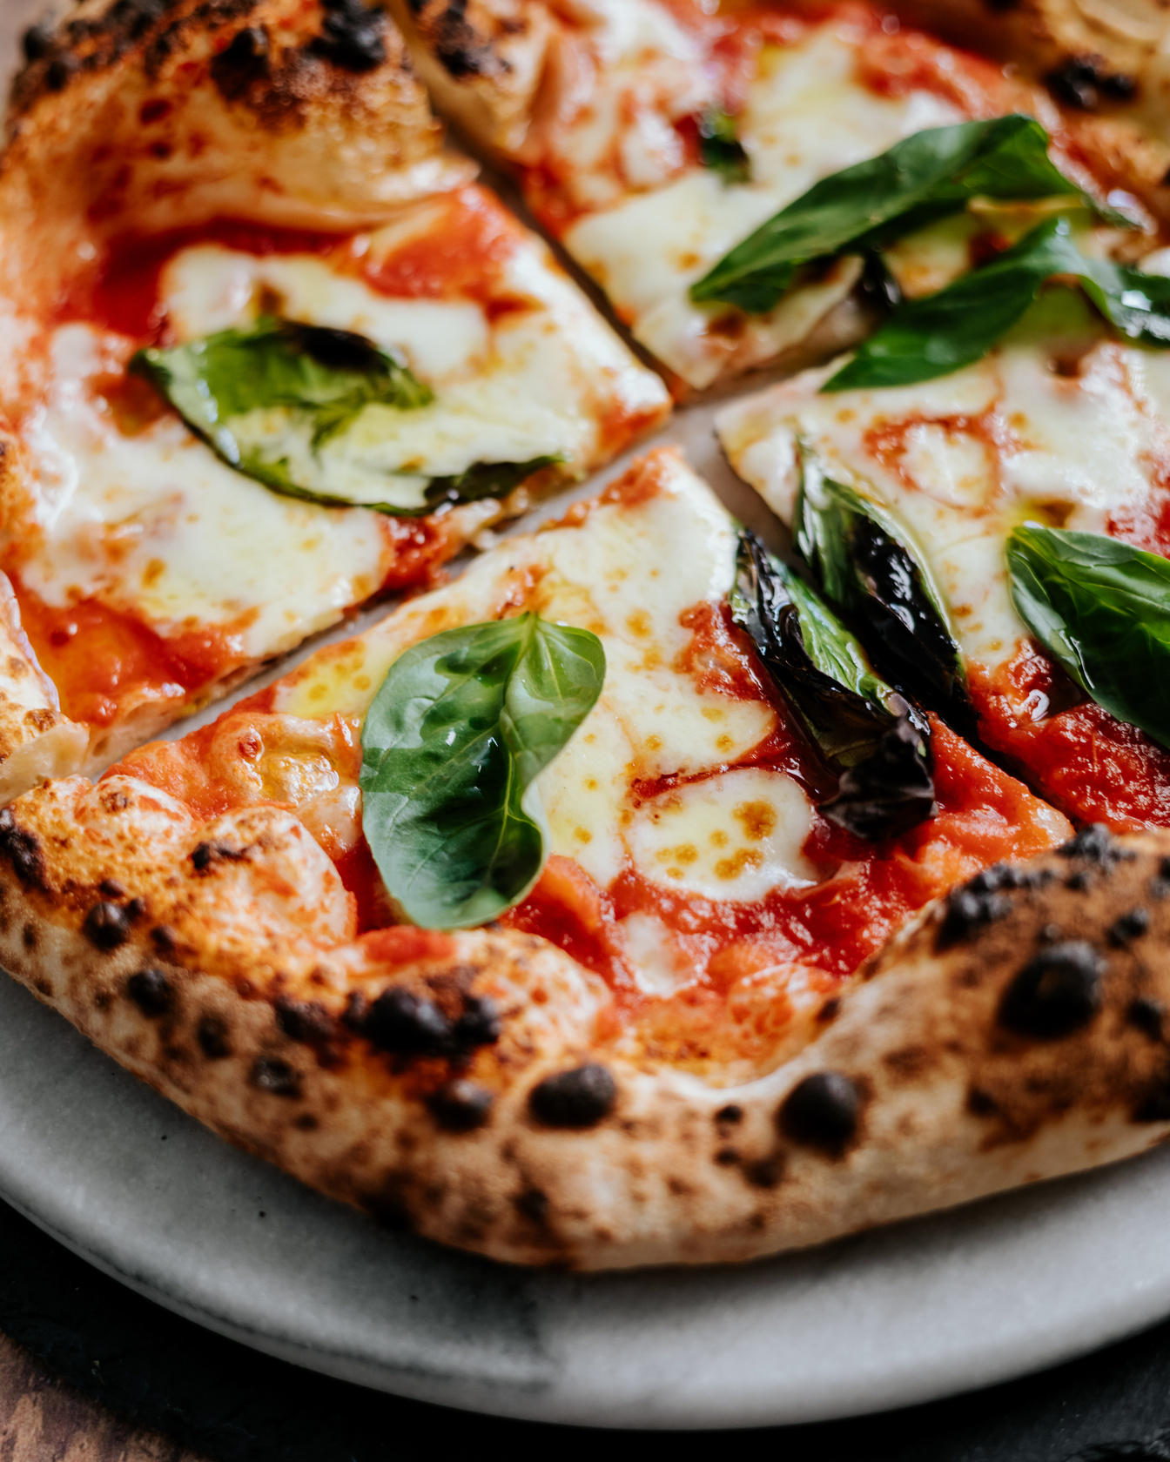
RELATION BETWEEN EVERY TABLES

Slide 3
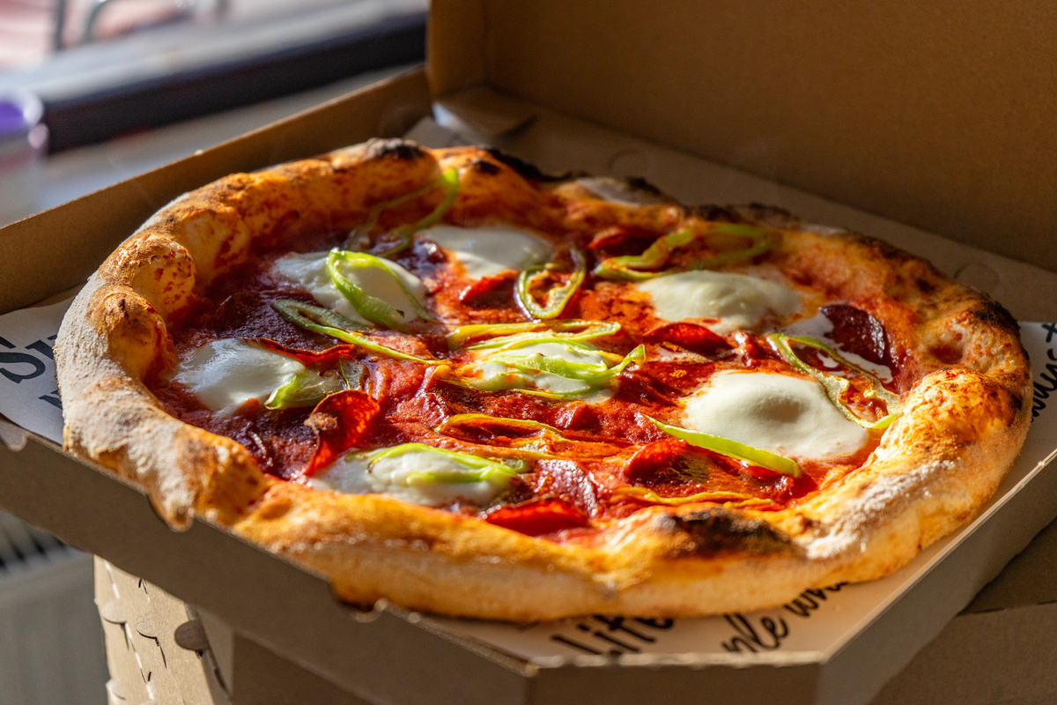
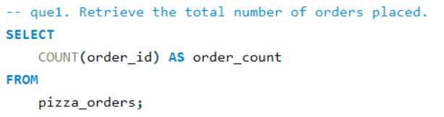
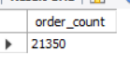
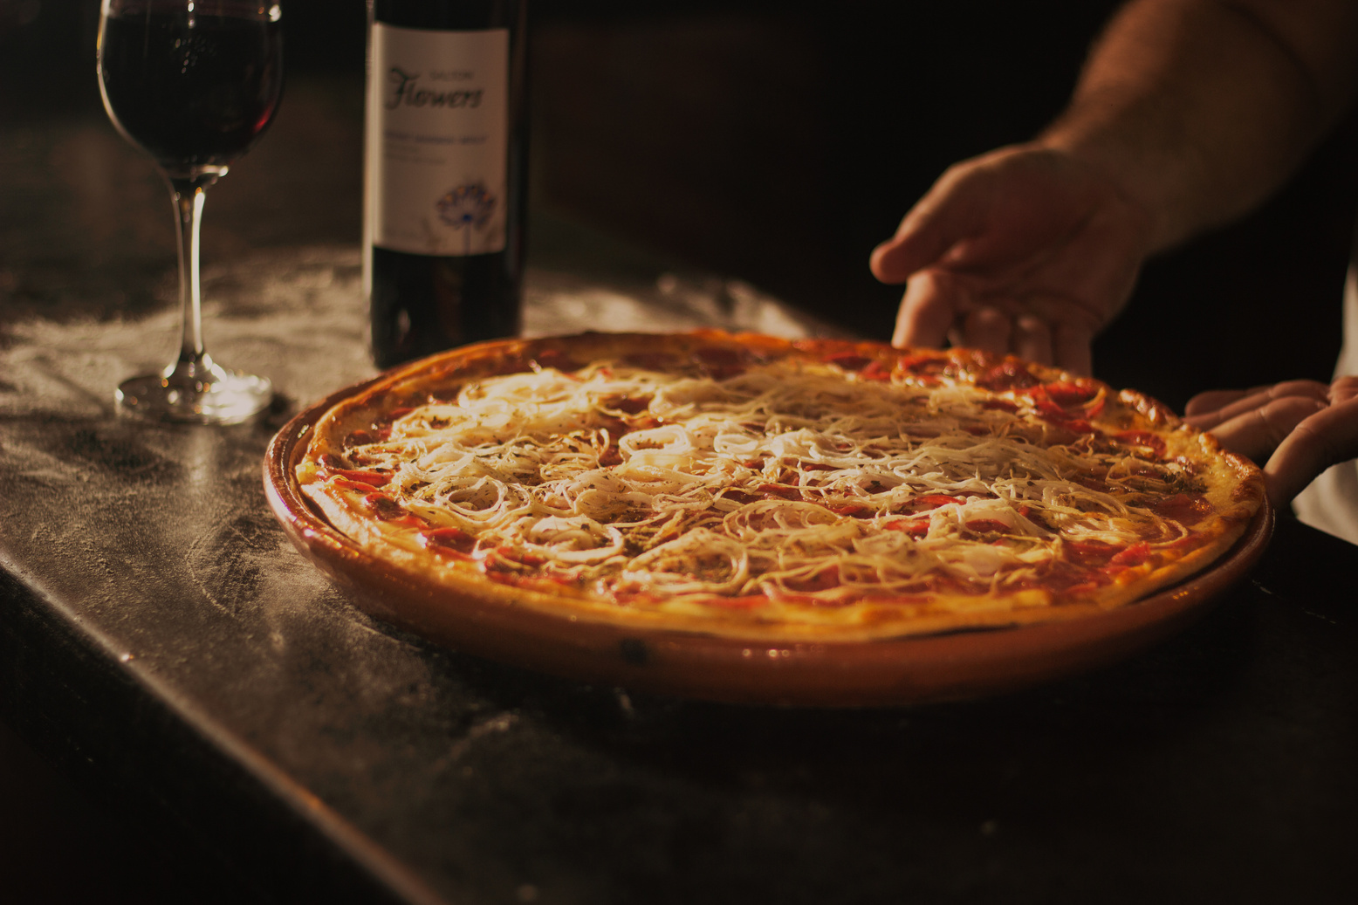
HOW MANY TOTAL NUMBER OF ORDERS ARE THERE ?

Slide 4
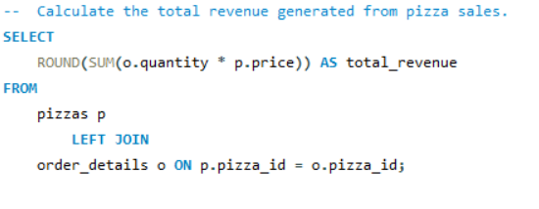
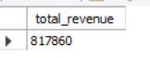
WHAT IS THE TOTAL REVENUE GENERATED?

Slide 5
WHAT IS THE TOTAL REVENUE GENERATED?

Slide 6
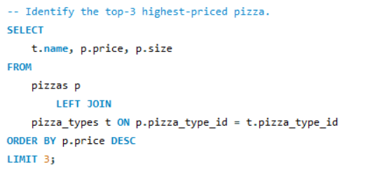
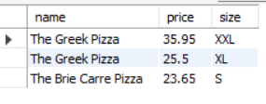
TOP 3 HIGHEST PRICE PIZZAS?

Slide 7
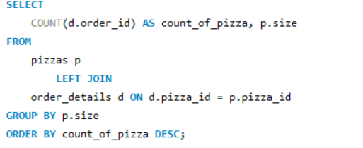
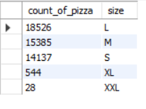
MOST COMMON PIZZAS SIZE ORDERED?

Slide 8
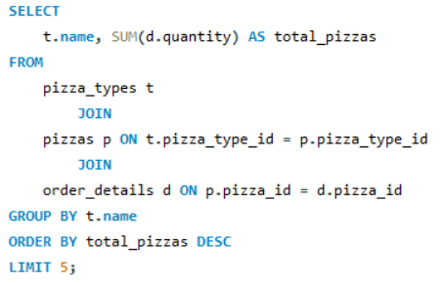
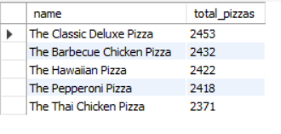
MOST ORDERED PIZZA TYPES ACC. TO QUANTITIES

Slide 9
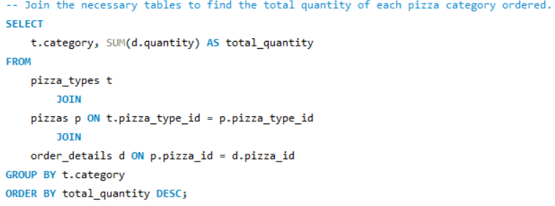
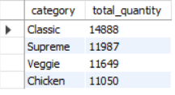
TOTAL NUMBER OF PIZZAS CATEGORY

Slide 10
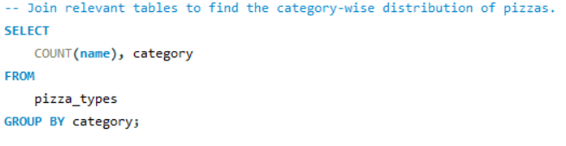
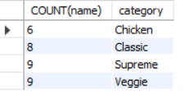
CATEGORY WISE DISTRIBUTION OF THE PIZZAS

Slide 11
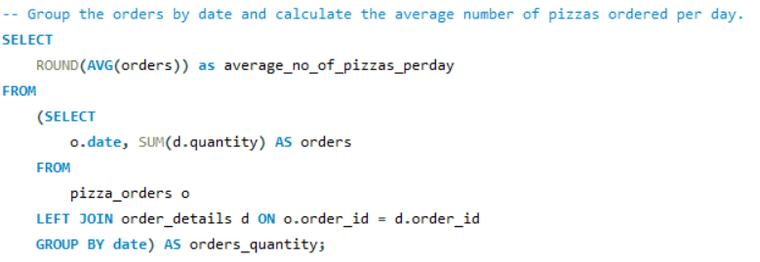
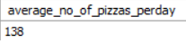
CALCULATE THE AVERAGE NO. OF PIZZAS PER DAY

Slide 12
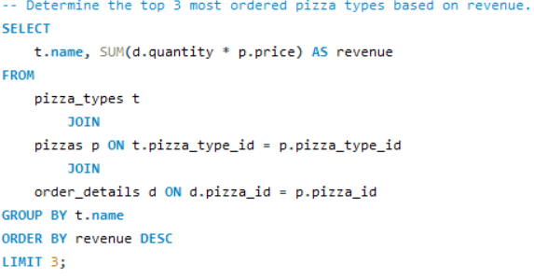
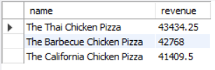
TOP 3 MOST ORDERED PIZZAS BY REVENUE

Slide 13
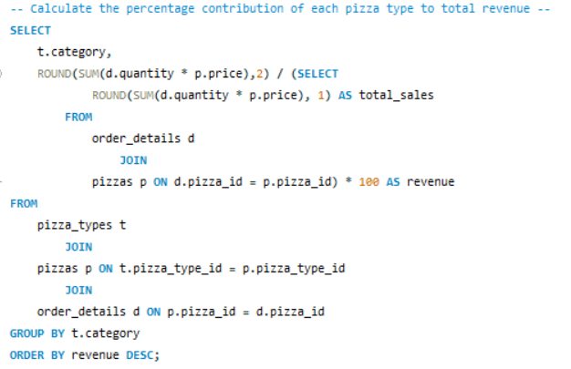
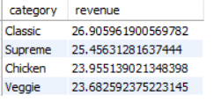
CALCULATE THE PERCENTAGE CONTRIBUTION OF EACH PIZZA TO TOTAL REVENUE

Slide 14
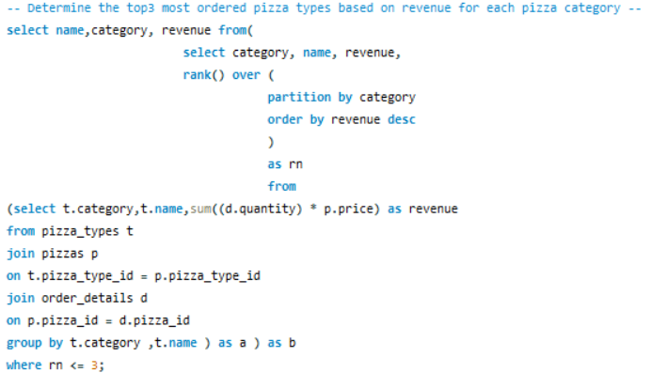
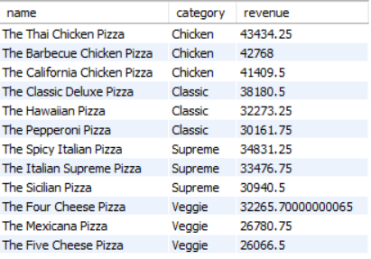
TOP 3 MOST ORDERED PIZZA NAMES BASED ON REVENUE FOR EACH PIZZA CATEGORY

Slide 15
THANK YOU

